Slide 1

IILM UNIVERSITY
Greater Noida, Uttar Pradesh
Internship Presentation
AI-Powered Automated Customer Support Chatbot
with Intent Recognition and CI/CD Deployment
STUDENT NAME
Swastik Srivastava
ENROLLMENT NUMBER
CS-23411535
PROGRAM & SEMESTER
B.Tech CSE(AI&ML), 7th Semester
ORGANIZATION
EduSkills Academy (AICTE - National Internship Portal)
1

Slide 2
Agenda
1
About the Internship Program
5
Methodology & Execution Timeline
2
Problem Statement & Objectives
6
CI/CD Automation Pipeline
3
Scope & Technology Stack
7
Results & Performance Evaluation
4
System Architecture
8
Key Outcomes, Limitations & Future Scope
2

Slide 3
About the Internship Program
EduSkills Academy is a nation-building skills initiative that delivers virtual internships in partnership with AICTE (All India Council for Technical Education) and the National Internship Portal, an initiative supported by the Ministry of Education, Government of India.
8
WEEKS
AI Deployment & Automation Track
Focused on building, containerizing and automating deployment of AI/ML applications.
Virtual Internship Duration
June - August 2026
Industry-Standard Toolchain
Hands-on exposure to Hugging Face, PyTorch, FastAPI, Docker and GitHub Actions.
Grade Achieved
O (Outstanding)
Mentor-Guided Execution
Structured 8-week roadmap with weekly milestones and deliverables.
3

Slide 4
Problem Statement & Objectives
PROJECT OBJECTIVES
THE PROBLEM
1
Fine-tune DistilBERT for accurate customer-intent classification
Organizations receive a high volume of repetitive, tier-1 customer support queries (order status, refunds, account queries). Manual handling increases operational cost and response time, and pulls agents away from complex issues that truly need human judgment.
2
Build a high-performance FastAPI REST endpoint for real-time inference
3
Containerize the application with Docker for portable deployment
There is a need for an intelligent system that understands customer intent in natural language and can be deployed and updated reliably, without manual intervention.
4
Automate testing, build & deployment using GitHub Actions CI/CD
5
Deploy on AWS EC2 / Render for public accessibility
4

Slide 5






Scope & Technology Stack
The project covers intent-based handling of tier-1 queries — model fine-tuning, API development, containerization and CI/CD-based automated deployment. Advanced multi-turn dialogue and generative responses are identified as future scope.
AI / ML
Validation
Backend API
Container
CI/CD
Cloud Host
Hugging Face + PyTorch
Pydantic Schemas
FastAPI
Docker & Compose
GitHub Actions
AWS EC2 / Render
5

Slide 6
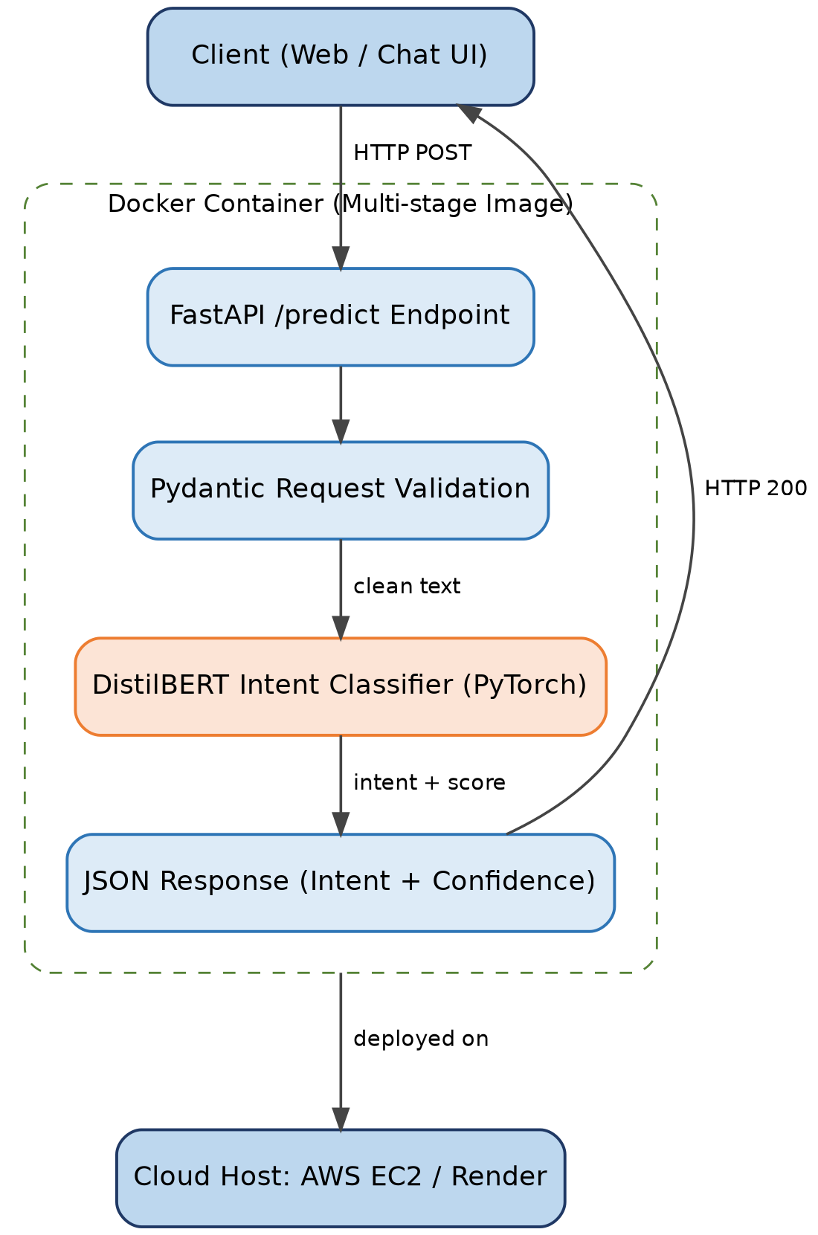
System Architecture
A modular, containerized microservice design: FastAPI handles routing, Pydantic validates input, and the fine-tuned DistilBERT model performs inference — all packaged in a single Docker image and deployed to the cloud.
1.
Client sends request via HTTP POST
2.
FastAPI /predict endpoint receives it
3.
Pydantic validates the payload
4.
DistilBERT classifies intent (PyTorch)
5.
JSON response returned with confidence score
6

Slide 7
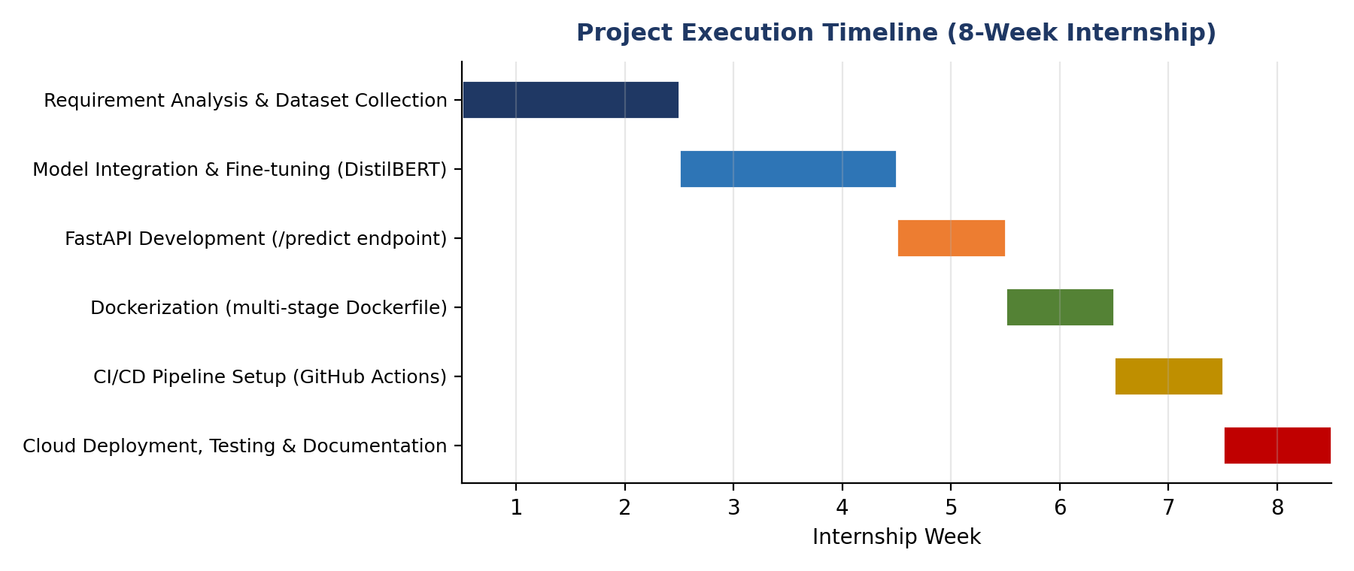
Methodology & Execution Timeline
The project followed a structured, phase-wise roadmap across the 8-week internship, moving from data preparation to a fully automated, cloud-deployed system.
Each phase builds on the last — from dataset preparation and model fine-tuning, through API development and containerization, to a fully automated CI/CD-driven cloud deployment by week 8.
7

Slide 8
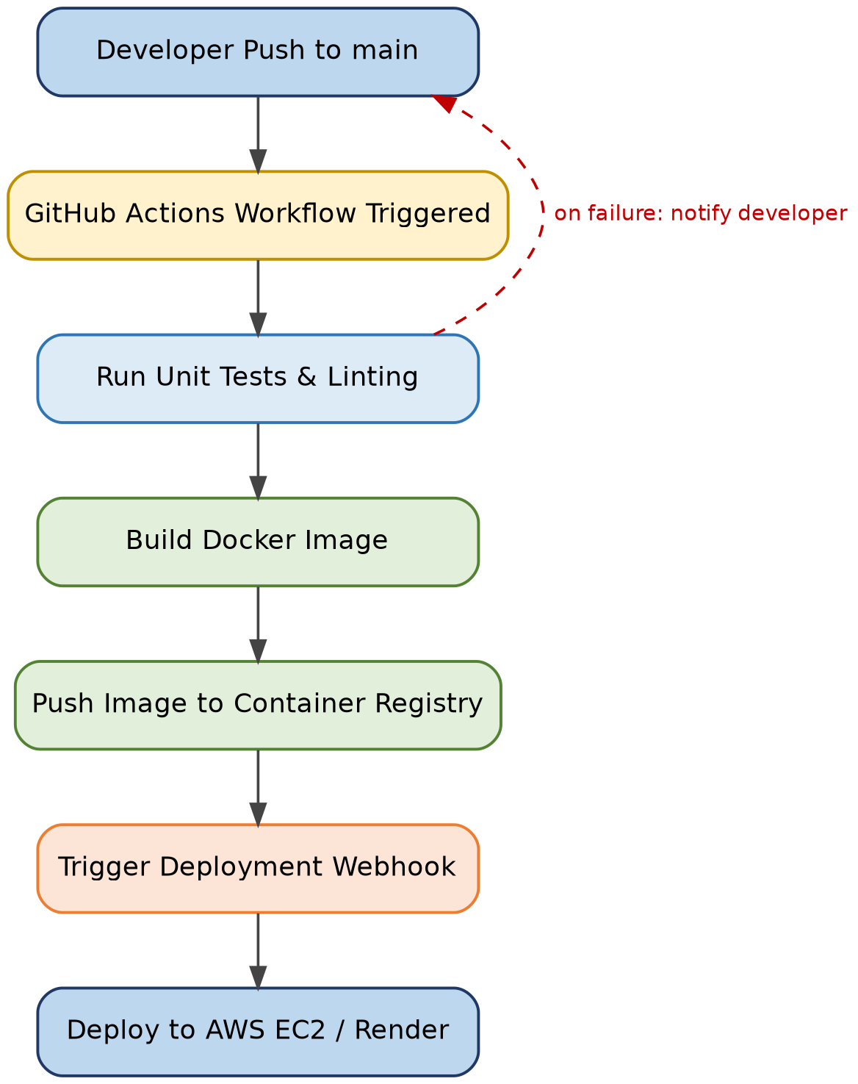
CI/CD Automation Pipeline
A GitHub Actions workflow tests, builds and deploys the application automatically on every push to the main branch — removing manual deployment steps entirely.
1
Run Tests & Linting
Every push automatically triggers unit tests and code-quality checks.
2
Build & Push Image
A multi-stage Dockerfile produces a minimal, secure production image.
3
Deploy Automatically
A webhook updates the live application on AWS EC2 / Render.
8

Slide 9
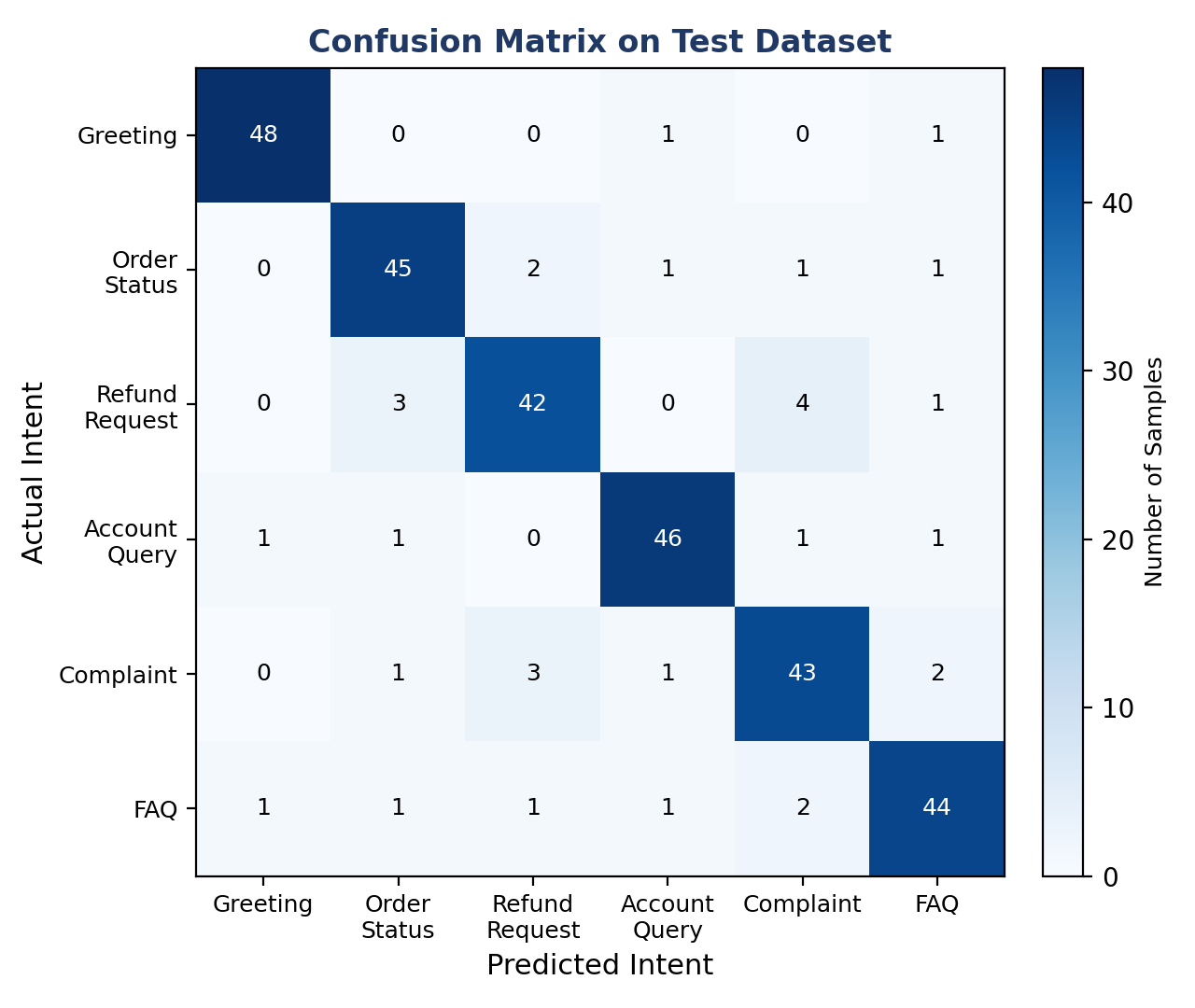
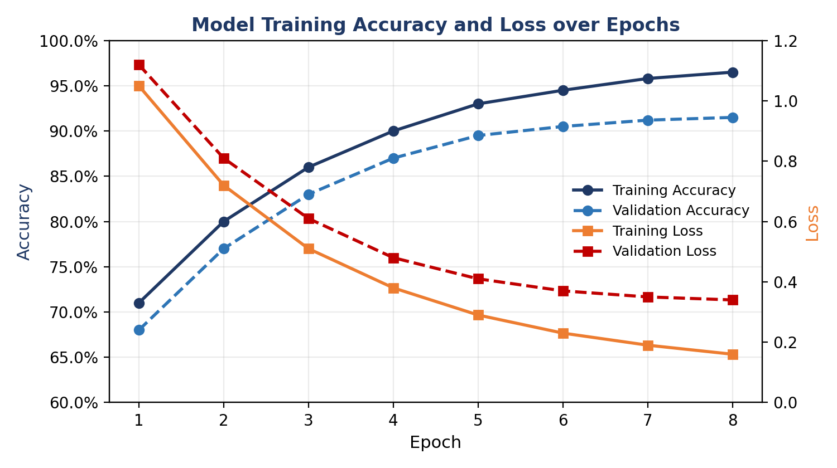
Results: Model Performance
Validation accuracy stabilises around 91-92% by epoch 8 with a small train/validation gap — indicating good generalization without overfitting.
Refund Request and Complaint show the most cross-confusion, reflecting overlapping vocabulary — a target area for future data augmentation.
9

Slide 10
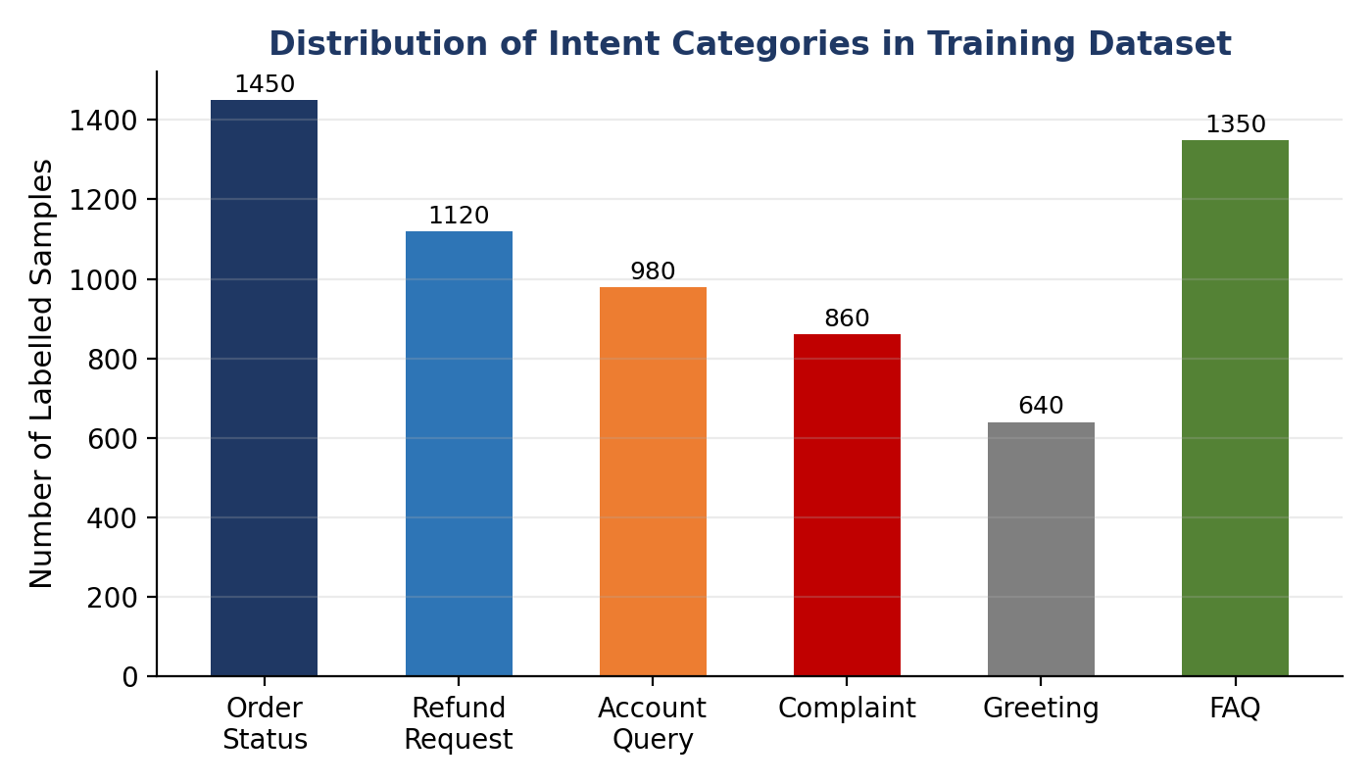
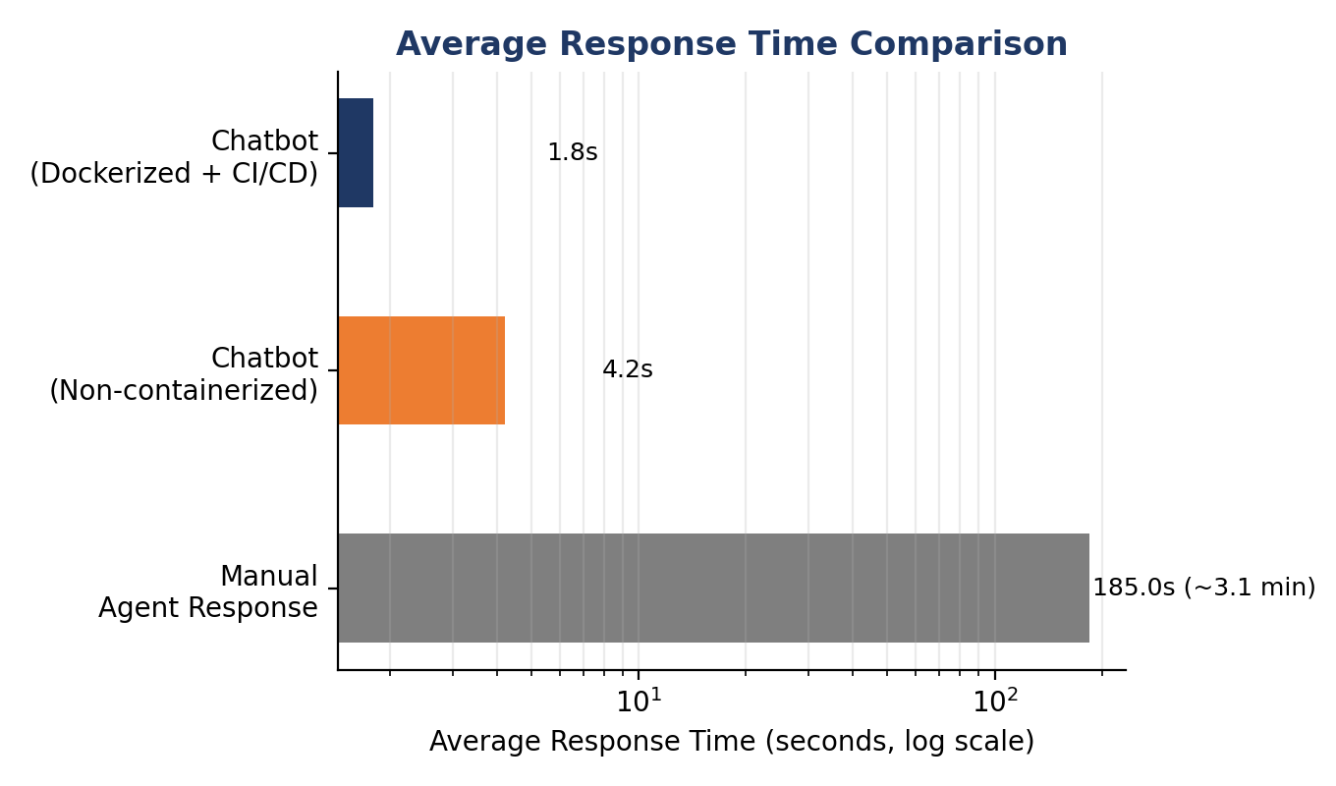
Results: Deployment Performance
91-92%
1.8s
100x+
8 wks
Test Accuracy
Avg. Response Time
(Dockerized + CI/CD)
Faster than Manual
Agent Response
End-to-End Build
& Deployment
10

Slide 11
Key Outcomes Achieved
✓
Fine-tuned DistilBERT model classifying customer intent with ~91-92% test accuracy
✓
Low-latency FastAPI REST endpoint (/predict) returning intent + confidence score
✓
Portable, containerized application deployable consistently via Docker
✓
Fully automated CI/CD pipeline — test, build & deploy on every push
✓
Live, cloud-hosted chatbot API accessible over the internet
✓
Reduced response time and operational load on human support agents
11

Slide 12
Limitations & Future Scope
CURRENT LIMITATIONS
PLANNED ENHANCEMENTS
No multi-turn conversational context
Multi-turn dialogue management
Fixed set of predefined intent categories
Generative responses via LLM integration
Unseen intents may be misclassified
Active learning loop for continuous improvement
Kubernetes autoscaling + monitoring (Prometheus/Grafana)
Multilingual intent support
12

Slide 13
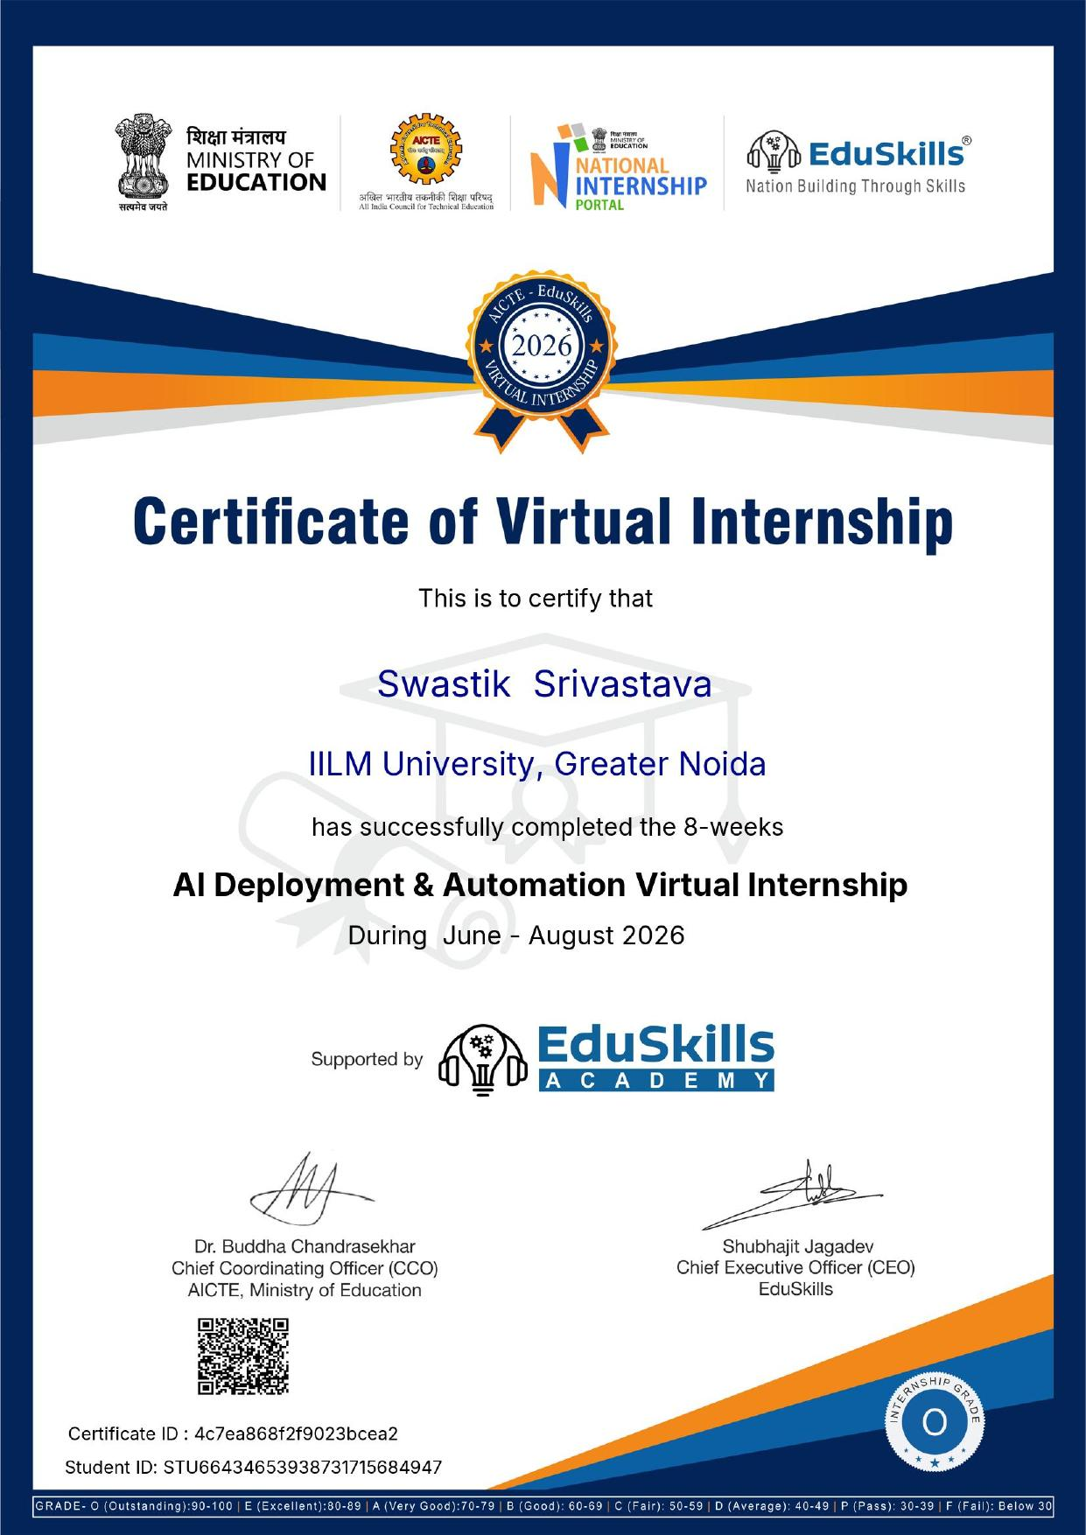
Internship Completion Certificate
13

Slide 14
Thank You
Swastik Srivastava | B.Tech CSE | IILM University, Greater Noida
14

